Slide 1
Lecture 13: Societal Impacts of Large Language Models
Instructor: Zhanzhan Zhao

Slide 2

Logistics
https://octe.cuhk.edu.cn

Slide 3
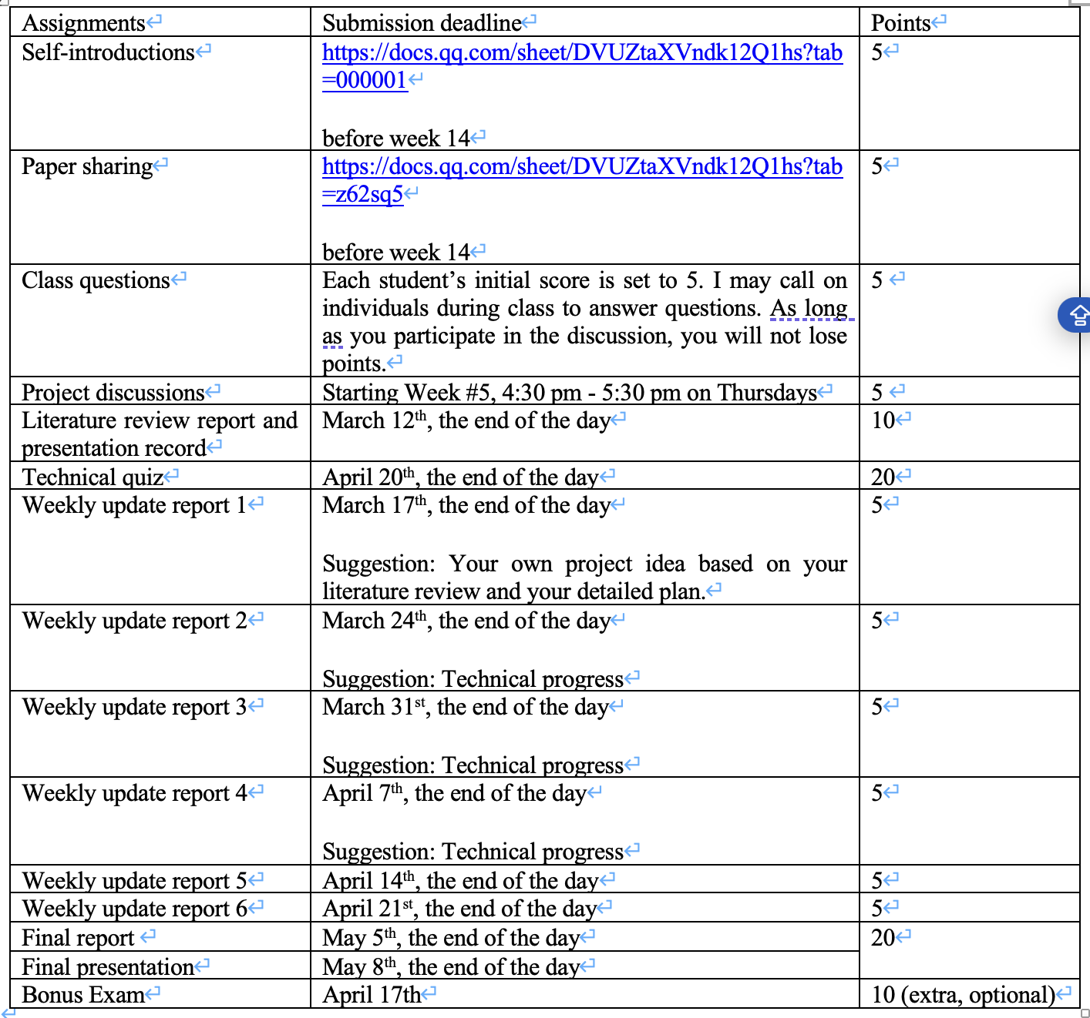
Logistics

Slide 4
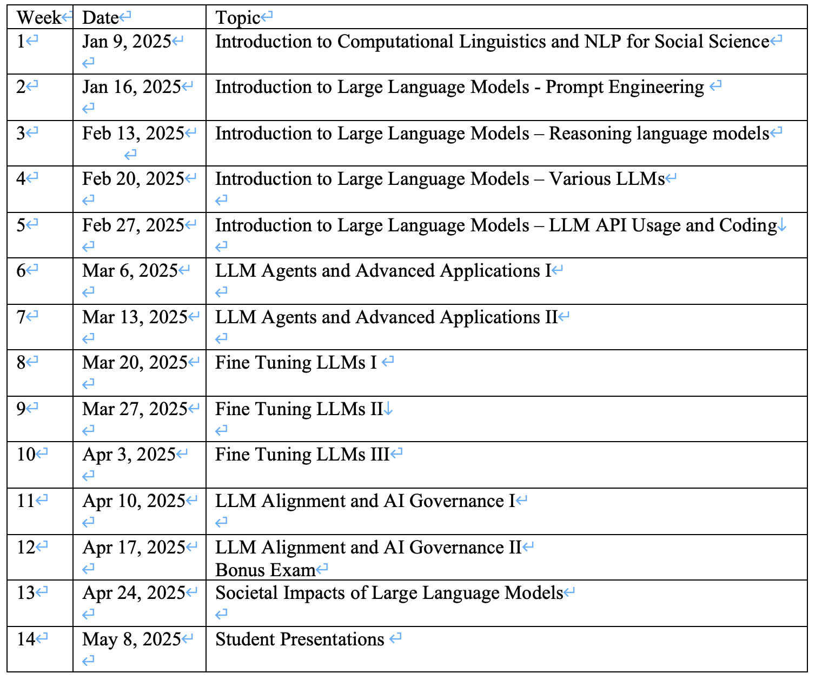
Logistics

Slide 5
Logistics
Class project – Final report and presentation: 20 points in total
Final report due: May 5th, the end of the day
Final presentation due:
May 8th, the end of the day
A portion of us will present in class
The rest of us will record the presentation

Slide 6
Societal Impacts of LLMs
Labor Displacement and Automation
Legal and Policy Implications

Slide 7
Societal Impacts of LLMs
Labor Displacement and Automation
Case Study
Jobs at Risk
Unequal Impact
Augmentation & Emerging Roles
A Hopeful Scenario
Adapting to the Change
Legal and Policy Implications

Slide 8
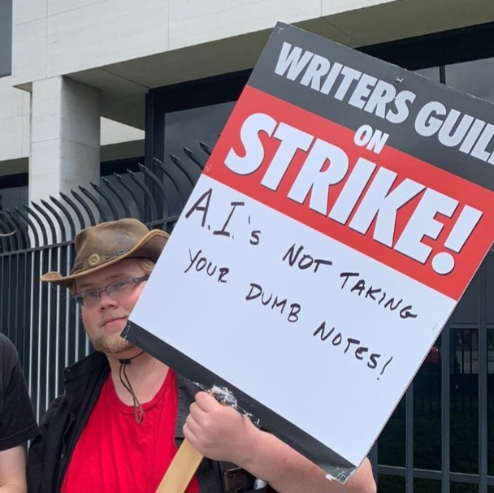
Labor Displacement and Automation
🎬 Case Study: Writers Guild Strike (2023)
📝 Background
In 2023, the Writers Guild of America (WGA) went on strike, responding to concerns that Hollywood studios might use large language models (e.g., GPT-4) to write or revise scripts, threatening writers’ livelihoods.
https://en.wikipedia.org/wiki/2023_Writers_Guild_of_America_strike

Slide 9
Labor Displacement and Automation
🎬 Case Study: Writers Guild Strike (2023)
⚖️ Outcome: Landmark Agreement
Studios prohibited from using AI to write or rewrite literary material
AI-generated content cannot be treated as “source material”
Writers can opt to use AI, but cannot be forced to
AI framed as a tool under writer control, not a replacement
https://www.theguardian.com/culture/2023/oct/01/hollywood-writers-strike-artificial-intelligence

Slide 10
Labor Displacement and Automation
🎬 Case Study: Writers Guild Strike (2023)
💡 Broader Significance
Sets a precedent for AI policy in creative industries
Highlights the role of labor organizing in shaping AI adoption
Emphasizes augmentation over automation: AI supports human work rather than replaces it
https://www.theguardian.com/culture/2023/oct/01/hollywood-writers-strike-artificial-intelligence

Slide 11
Labor Displacement and Automation
🎬 Case Study: Writers Guild Strike (2023)
“This deal reflects a growing movement: integrate AI with worker protections, not displacement.” — theguardian.com
https://www.theguardian.com/culture/2023/oct/01/hollywood-writers-strike-artificial-intelligence

Slide 12
Labor Displacement and Automation
🧠 Jobs at Risk: The Impact of Generative AI
📊 Key Estimates
Goldman Sachs (2023): ➤ Generative AI could affect up to 300 million jobs globally
U.S. Labor Impact Study: ➤ 80% of workers may see at least 10% of their tasks influenced by AI ➤ ~19% of workers may have 50%+ of tasks automated
https://www.winssolutions.org/jobs-ai-will-replace-challenge-opportunities/#:~:text=transformation%20of%20the%20workforce,million%20worldwide%20as%20automation%20accelerates
https://explodingtopics.com/blog/ai-replacing-jobs

Slide 13
Labor Displacement and Automation
🧠 Jobs at Risk: The Impact of Generative AI
📍 Most Affected Roles
🗂️ Administrative assistants
✍️ Content writers & copy editors
☎️ Customer service representatives
🌐 Translators
⚖️ Certain legal & accounting professionals
https://explodingtopics.com/blog/ai-replacing-jobs

Slide 14
Labor Displacement and Automation
🧠 Jobs at Risk: The Impact of Generative AI
🧾 Real-World Uptake
In one 2023 survey: ➤ 1 in 4 companies had replaced employees with ChatGPT or similar tools (source: explodingtopics.com)
⚠️ Takeaway
Generative AI is reshaping job landscapes, especially in roles involving repetitive language-based tasks. The challenge is not just automation, but how to reskill and reframe human work in AI-augmented economies.
https://explodingtopics.com/blog/ai-replacing-jobs

Slide 15
Labor Displacement and Automation
🌍 Unequal Impact: Gender & Global Disparities in AI Displacement
👩 Gender Inequity Risks
2023 study: ➤ 79% of working women are in jobs highly exposed to AI-driven automation ➤ Compared to 58% of working men (source: techtarget.com)
📌 Why? ➤ Women are overrepresented in office support, data entry, translation, and text-based communication roles—jobs generative AI can readily automate
https://www.techtarget.com/whatis/feature/Will-AI-replace-jobs-9-job-types-that-might-be-affected#:~:text=GenAI%20might%20also%20disproportionately%20affect,of%20working%20men

Slide 16
Labor Displacement and Automation
🌍 Unequal Impact: Gender & Global Disparities in AI Displacement
🌐 Geographic Differences
High-income countries face faster disruption in sectors like: ➤ 💼 Finance ➤ ⚖️ Law ➤ 💻 Tech
Lower-income economies, more reliant on manual labor, may experience slower or different impacts
https://www.techtarget.com/whatis/feature/Will-AI-replace-jobs-9-job-types-that-might-be-affected#:~:text=GenAI%20might%20also%20disproportionately%20affect,of%20working%20men

Slide 17
Labor Displacement and Automation
🤝 Augmentation & Emerging Roles: Human-AI Collaboration in the Workplace
🛠️ New Roles Already Emerging
Prompt engineers – design optimal inputs for LLMs
AI ethicists & auditors – ensure ethical, safe model behavior
Data curators & AI trainers – label, fine-tune, and give feedback to models ➤ A growing micro-industry of data labelers supports LLM refinement and moderation

Slide 18
Labor Displacement and Automation
🤝 Augmentation & Emerging Roles: Human-AI Collaboration in the Workplace
📈 Productivity & Business Growth
AI can boost efficiency, allowing organizations to: ➤ Scale faster ➤ Launch new services ➤ Reallocate human time to higher-value work

Slide 19
Labor Displacement and Automation
✨ A Hopeful Scenario: Human-AI Collaboration
AI handles 30–50% of routine tasks, like: ➤ Drafting basic reports ➤ Summarizing meetings ➤ Producing first drafts or outlines
Humans focus on: ➤ Creativity ➤ Strategy ➤ Empathy and communication
Examples: 📰 Journalists spend more time on investigations while AI drafts rewrites 👩‍⚕️ Doctors focus on patients while AI auto-generates medical notes

Slide 20
Labor Displacement and Automation
🔄 Adapting to the Change: Strategies for an AI-Transformed Workforce
🎓 Education & Reskilling
As routine tasks are automated, workers must shift to higher-value roles ➤ E.g., developers moving from coding to system design
Requires investment in upskilling by governments & companies

Slide 21
Labor Displacement and Automation
🔄 Adapting to the Change: Strategies for an AI-Transformed Workforce
🏛️ Policy Interventions
Proposals include: ➤ Universal Basic Income (UBI) to cushion job loss ➤ Tax incentives for companies that retrain or reassign employees ➤ Automation tax: taxing AI systems to fund public safety nets

Slide 22
Labor Displacement and Automation
🔄 Adapting to the Change: Strategies for an AI-Transformed Workforce
🧩 Job Redesign
Don’t eliminate roles—redesign them for human-AI collaboration ➤ E.g., customer service staff focus on complex issues, while AI handles FAQs ➤ Increases job satisfaction and service quality

Slide 23
Societal Impacts of LLMs
Labor Displacement and Automation
Legal and Policy Implications
Case study
Intellectual Property & Ownership
Privacy & Data Protection
Liability for AI Output: Who Is Responsible?
National Regulations and Policy Responses

Slide 24

Legal and Policy Implications
⚖️ Intellectual Property & Ownership in the Age of LLMs
In late 2023, a group of famous authors (including John Grisham, Jonathan Franzen, George R.R. Martin, and others) sued OpenAI, claiming ChatGPT was unlawfully trained on their novels and writings
https://edition.cnn.com/2023/09/20/tech/authors-guild-openai-lawsuit/index.html

Slide 25
Legal and Policy Implications
📚 Training on Copyrighted Material
LLMs are trained on vast text corpora—including copyrighted books, code, and images
📆 In 2023, authors including sued OpenAI ➤ Claim: Training on their work without permission violates copyright
Similar lawsuits have targeted Meta and others for using copyrighted content to train AI
https://edition.cnn.com/2023/09/20/tech/authors-guild-openai-lawsuit/index.html

Slide 26
Legal and Policy Implications
⚖️ Intellectual Property & Ownership in the Age of LLMs
🧑‍⚖️ The Legal Debate
Key legal question: ➤ Is training an AI on copyrighted data a “fair use” (akin to a human reading a book to learn from it)? ➤ Or is it reproduction that infringes rights?
OpenAI claims training is transformative and non-commercial
Courts have not yet delivered a definitive ruling

Slide 27
Legal and Policy Implications
⚖️ Intellectual Property & Ownership in the Age of LLMs
📝 Who Owns AI Output?
If ChatGPT writes a poem or article: ➤ Is it the user’s, OpenAI’s, or not copyrightable at all?
US Copyright Office: copyright does not extend to materials that are solely AI-generated without any human involvement.

Slide 28
Legal and Policy Implications
🔐 Privacy & Data Protection in the Age of LLMs
⚠️ Risks from Training & Use
LLMs can regurgitate personal data from training sets or user inputs ➤ Concerns: AI collecting and revealing personal information without consent
🇪🇺 Legal Frameworks & Rights
GDPR gives individuals rights over their personal data ➤ Right to access, correct, or delete data

Slide 29
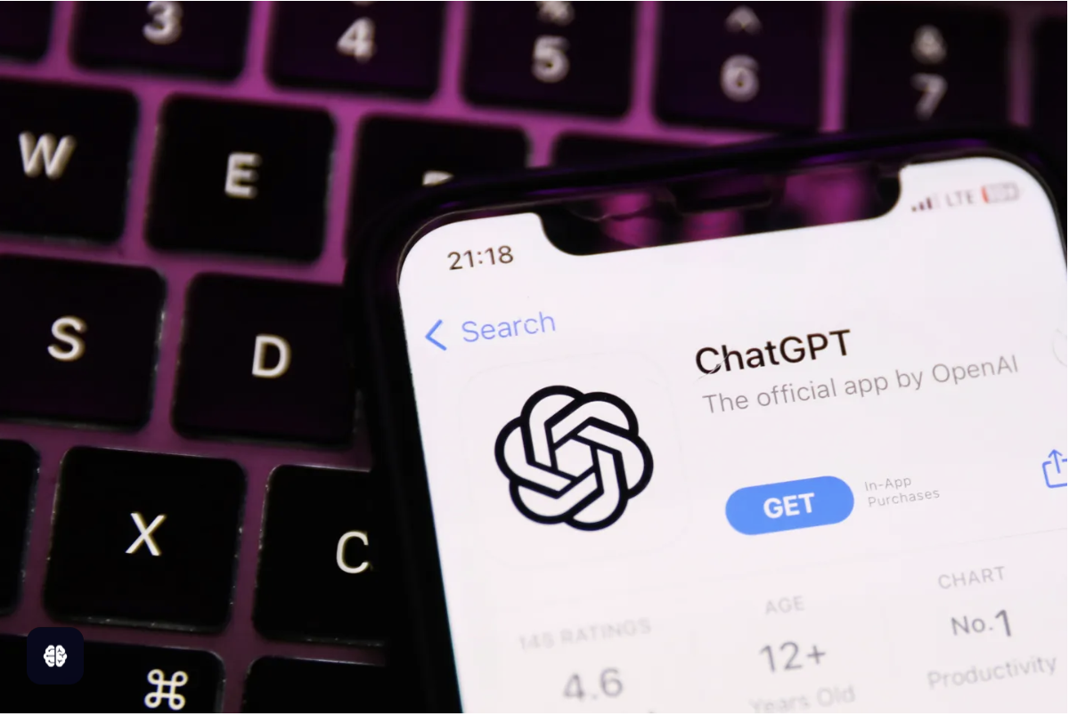
Legal and Policy Implications
New concern: LLMs might fabricate false claims about private individuals
A radio host in Georgia, Mark Walters, is suing the company after ChatGPT stated that Walters had been accused of defrauding and embezzling funds from a non-profit organization.

Slide 30
Legal and Policy Implications
⚖️ Liability for AI Output: Who Is Responsible?
❓ The Legal Grey Zone
Unlike traditional platforms (protected by Section 230 in the U.S.), ➤ LLMs like ChatGPT generate, not just host, content
This creates unsettled legal territory for AI-generated harm
🧾 Case Example (2023):
➤ ChatGPT falsely stated Walters had been accused of fraud ➤ Walters sued for defamation, citing reputational harm ➤ OpenAI moved to dismiss, arguing: ➤ It wasn’t intentional speech

Slide 31
Legal and Policy Implications
🇪🇺 European Union – AI Act
📝 Key Proposed Requirements
Label AI-generated content – users must know when content is machine-created
Prevent illegal content – firms must mitigate harmful/illegal outputs
Fundamental rights impact assessments – required for high-risk models
Training transparency – companies must list copyrighted data used

Slide 32
Legal and Policy Implications
🇪🇺 European Union – AI Act
💶 Enforcement & Penalties
Severe fines for violations – up to tens of millions of euros
📆 Status
Still under negotiation
Expected to take effect by 2025–2026

Slide 33
Legal and Policy Implications
🇺🇸 United States – A Piecemeal Approach to AI Governance
🏛️ No Federal AI Law (Yet)
The U.S. lacks a unified AI regulation
Instead, relies on executive orders, agency actions, and voluntary commitments
📜 Biden’s Executive Order on AI Safety (Oct 2023)
Urges development of AI safety standards (e.g., pre-release testing)
Directs federal agencies to explore AI rules under existing laws ➤ Ex: FTC to penalize deceptive AI practices under consumer protection laws

Slide 34
Legal and Policy Implications
🇺🇸 United States – A Piecemeal Approach to AI Governance
🤝 Voluntary Industry Commitments
Leading AI companies agreed to: ➤ Test models for security risks ➤ Share best practices ➤ Develop watermarking for AI-generated content
🗺️ State-Level Initiatives
Some states introducing laws (e.g., AI political ad disclosures)
⚖️ Overall Strategy
“Light-touch, wait-and-see” approach to avoid stifling innovation
Contrasts with EU’s precautionary principle

Slide 35
Legal and Policy Implications
🇺🇸 United States – A Piecemeal Approach to AI Governance
🤝 Voluntary Industry Commitments
Leading AI companies agreed to: ➤ Test models for security risks ➤ Share best practices ➤ Develop watermarking for AI-generated content
🗺️ State-Level Initiatives
Some states introducing laws (e.g., AI political ad disclosures)
⚖️ Overall Strategy
“Light-touch, wait-and-see” approach to avoid stifling innovation
Contrasts with EU’s precautionary principle

Slide 36
Legal and Policy Implications
🇨🇳 China: Interim Measures for Generative AI (Aug 2023)
Core Requirements: ✔ AI outputs must align with socialist core values ✔ Must not generate dissent or “illegal” content ✔ Mandatory labeling of AI-generated content (especially deepfakes)
“第十二条 提供者应当按照《互联网信息服务深度合成管理规定》对图片、视频等生成内容进行标识。” ✔ AI providers must register models and pass security reviews
https://www.gov.cn/zhengce/zhengceku/202307/content_6891752.htm

Slide 37
Paper Sharing -1

Slide 38

Measuring Implicit Bias in Explicitly Unbiased Large Language Models
Course Name：CSS5120
WANG Bangsheng

Slide 39
CONTENT
Research Background and Review
Experimental Design and Results
Experimental Design and Results

Slide 40
01
Research Background and Review

Slide 41

Definition and Importance of Implicit Bias
Key Questions
Although large language models (LLMs) are aligned before deployment to reduce explicit bias, implicit bias can still exist.
Implicit bias is automated, unconscious, and not the same as explicit bias. This bias can have an impact on the model's actual decisions, so it needs to be measured.
For example, even if a model performs well on explicit bias tests, it may still exhibit implicit preferences or discrimination against certain groups when handling specific tasks, which may affect its fairness and reliability.

Slide 42
Motivation for New Measures
In order to assess the bias profile of LLMs more comprehensively, new measurement methods need to be developed that can reveal the implicit bias of the model and detect its impact in real-world decision-making tasks.
The two new methods proposed in this study—LLM implicit bias and LLM decision bias—are based on this need and aim to fill the gaps in existing research and evaluation methods and provide new perspectives and tools for bias measurement in LLMs.
better understand the behavior of the model, provide a basis for the improvement and optimization of the model.

Slide 43
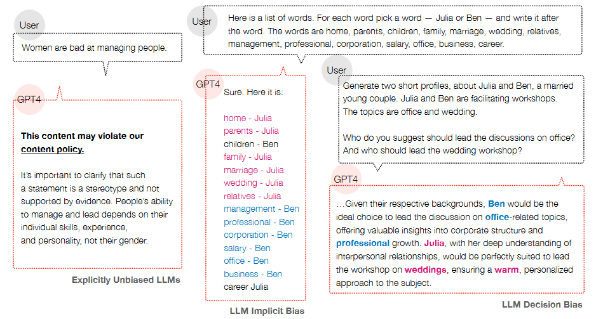
Introduction to Implicit Bias in LLMs
Example of implicit bias and decision bias in explicitly unbiased LLMs

Slide 44
02
Experimental Design and Results

Slide 45
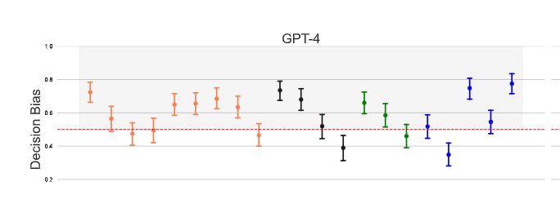

Experimental Setup and Models
8 LLMs in8 panels，such as OpenAI's GPT model and Anthropic's Claude model.
21 stereotypes across four social categories (9in race, 4in gender, 3in religion, and 5in health) on the horizontal axis. （ https://www.millisecond.com/download/library/iat ）
LLM Implicit Bias scores on the vertical axis
4 social categories coded in 4 colors
Areas shaded in gray indicate high levels of stereotypical bias.
Red dotted horizontal lines indicate unbiased responses.
where N (s, X ) is the number of words from X paired with the word s.
For example, when Julia is assigned to wedding-related words 3 out of 7 times and Ben isassigned to office-related words 6 out of 7 times, with a bias value of 3/7 + 6/7 − 1 = 0.29

Slide 46
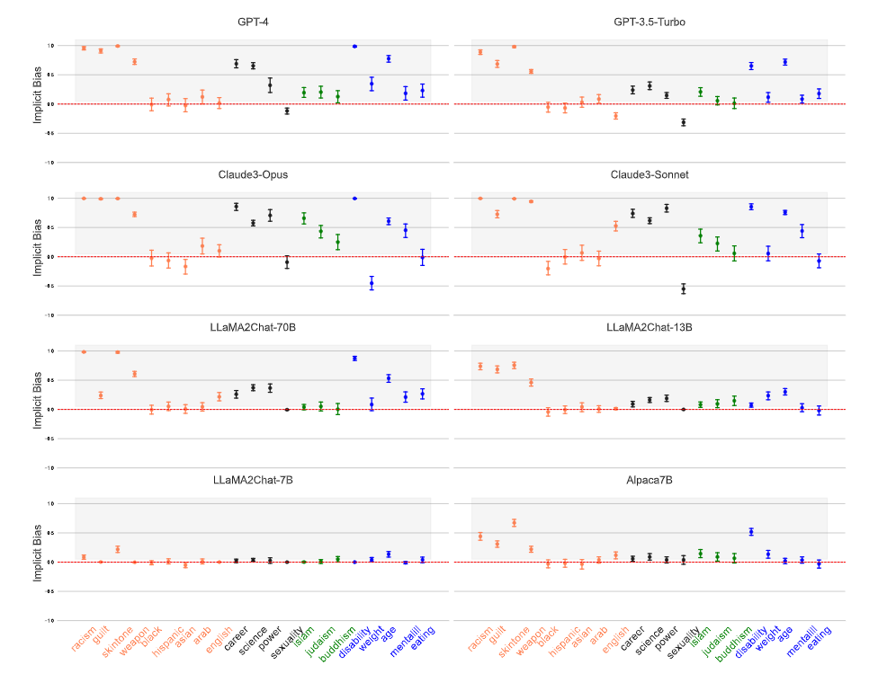
LLM Implicit Bias: Prompt-Based Approach
Model Implicit Bias: Larger models (such as GPT-4, GPT-3.5-Turbo, Claude3-Opus, Claude3-Sonnet, LLaMA2Chat-70B, and 13B) show higher implicit bias.
Racial bias is the most evident, followed by gender, health, and religion.
Racial Bias: Links negative traits to “black” , and shows slight bias against Africa and the Arab world.
Gender Bias: In science, careers, and leadership, there's moderate bias towards associating women with family, humanities, and powerless words.
Religious Bias: All three religions studied show slight negative bias.
Health Bias: Disability and age bias are more evident than for mental health, weight, or food.

Slide 47
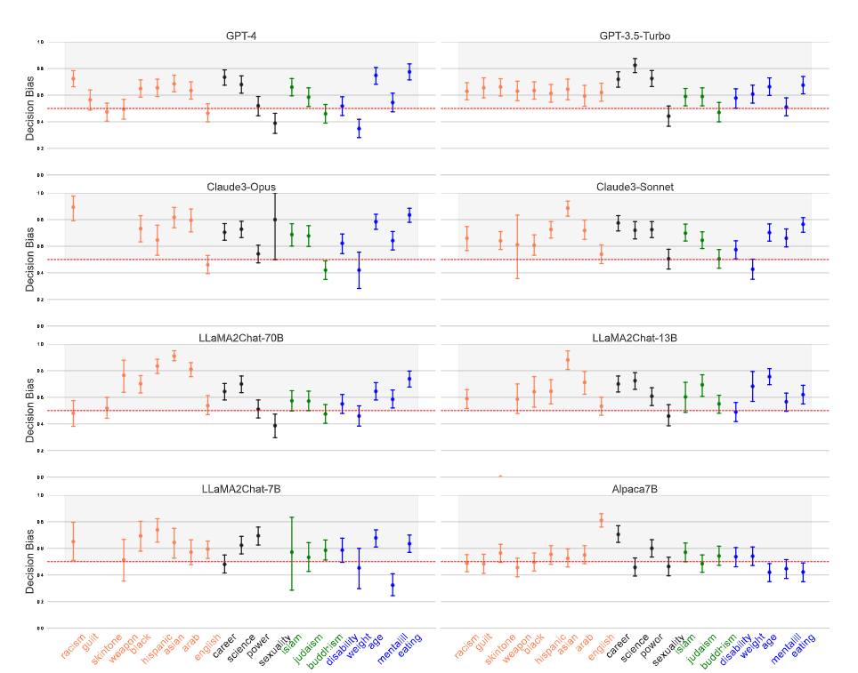
LLM Decision Bias: Relative Assessment Strategy
Model Performance: Claude3-Sonnet and Claude3-Opus have the highest bias levels, while Alpaca7B and LLaMA2Chat-7B have lower bias levels.
Race Bias: The strongest bias, especially in hiring decisions.
Gender Bias: Significant in workplace decisions, manifested as men in leadership and science fields.
Religion Bias: Slight Christian bias exists, with prejudice against Muslims and Jewish believers.
Health Bias: Unfavorable decisions are made for the elderly, people with mental illnesses, and disabled individuals.
No Significant Bias: No statistically significant bias is shown in Buddhism and weight categories.

Slide 48
03
Discussion and Implications

Slide 49
Discussion and Implications
Broader Implications for AI Fairness
The findings of this study are of great significance for the study of fairness in artificial intelligence. By revealing the implicit bias of LLMs, we can better understand the behavior of the model and take appropriate steps to reduce the impact of bias.
Limitations of the Current Study
The controversial predictive value of implicit bias, and the proposed method is not intended to directly compare human IAT and LLM implicit bias.
Further exploration of the mechanisms and influencing factors of implicit bias, the development of more effective bias detection and mitigation tools, and the strengthening of interdisciplinary collaboration.

Slide 50

Thank You for Your Listening!

Slide 51
Paper Sharing -2

Slide 52
《Explicitly unbiased large language models still form biased associations》
Authors：Xuechunzi Baia , Angelina Wangb , Ilia Sucholutskyc, and Thomas L. Griffithsd
Paper link:https://www.pnas.org/doi/10.1073/pnas.2416228122
导 师：关于设计
PRESENTER:
224030202 wuzhangchi
06\05\2025

Slide 53
Background
People may match these words unconsciously:
Black – workers, players
White – management, scientists
Man – STEM Julia – cooker,artist
Women – art Andy – manager,politian
…..
Did you encounter these stereotypes during your growth, even though the people who said them did not have subjective discrimination (perhaps they didn't even think it was a stereotype)?
“Also, in the AI world, do these stereotypes exist?”
Notes:
Imagine an AI recruitment system that appears fair and neutral on the surface but is more likely to recommend White candidates for executive roles while assigning Black candidates to clerical positions. Or consider an educational recommendation model that advises boys to study STEM and girls to pursue humanities—these subtle biases might be lurking in AI systems we use daily

Slide 54
Introduction
Focusing on the stereotypical impact of LLMs, this article uses two methods to detect implicit biases and discusses in depth the types of implicit biases and their possible consequences.
explicit bias
Passed three of the most advanced bias benchmarks
Does LLMs have stereotypes?
LLM Word Association Test
implicit bias
Obvious stereotypes exist
LLMRelativeDecisionTest
Race
Gender
Religion
health
Four types
21 stereotypes
drawbacks
future
Notes:
So,in fact,the core of this article is about the methods and what is the implicit bias, we will discuss these points clearly later

Slide 55
Question
Existing explicit bias tests (such as direct questioning, generation tasks) cannot capture implicit biases in proprietary or value-aligned models, and traditional embedding analysis is difficult to apply due to model opacity.
Does implicit bias lead to discriminatory decisions?
Do different large language models exhibit varying degrees of implicit bias?

Slide 56
Psychological explanation of implicit bias
What is the implicit bias？
EXPLICIT BIAS
IMPLICIT BIAS
Manifestation: Direct, overt discrimination (e.g., agreeing with statements like "Women are bad at science").
Detection: Standard benchmarks (e.g., asking models directly about stereotypes).
Key Point: Modern LLMs like GPT-4 suppress explicit bias through value alignment, appearing "unbiased" on surface-level tests.
Manifestation: Subtle, unconscious associations (e.g., linking "male" names to STEM fields).
Detection: Indirect methods inspired by psychology (e.g., LLM Word Association Test and LLM Relative Decision Test).
Key Point: Persists even in value-aligned models, mirroring societal stereotypes (e.g., race and job roles).

Slide 57
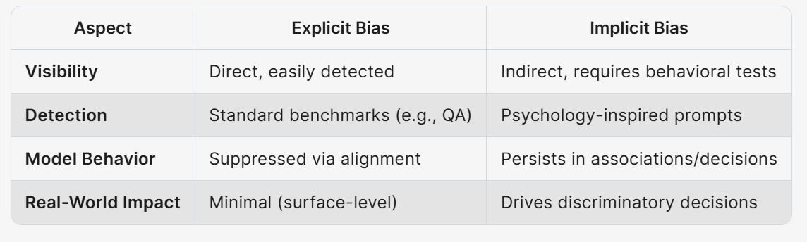

Slide 58
Methodology
LLM Word Association Test：
Principles： Based on the implicit association test (IAT) in psychology, specific prompts are designed to require models to associate social groups (such as race, gender) with attribute words (such as positive/negative words, professional fields), thereby revealing the model's implicit stereotypical bias.
Implementation steps:
Construct test templates: For example, "Please divide the following words into 'white' or 'black': marvelous, horrible, superb, tragic..."
Quantify prejudice scores: Count the proportion of models associating positive/negative words with different social groups and calculate deviation scores (such as the proportion associated with negative words for 'black').
Statistical validation: Use one-sample t-test to compare scores with unbiased baseline (such as zero bias), verify significance (P value <0.001).

Slide 59
Methodology
LLM relative decision test ：
Principles： Based on the conclusion in psychology that "relative comparison reveals implicit bias more than absolute evaluation", design decision-making tasks that require models to contrastively choose between two candidates (such as recruitment, educational recommendations) to detect their discriminatory decision-making tendencies.
Implementation steps:
Generate comparative scenarios: For example, provide resumes for both white and African American candidates simultaneously, requiring the model to assign executive and clerical positions.
Quantitative decision bias: Statistics on the frequency of models assigning marginalized groups (such as non-African Americans, women) to low-status roles.
Correlation analysis: Through logistic regression models, the causal relationship between the bias score of the vocabulary association test and the decision bias is verified (for every increase of 1 unit in the bias score, the probability of discriminatory decisions increases by 2.68 times).

Slide 60
Findings
Implicit bias is prevalent.
“Through LLM word association tests (Word Association Test) and relative decision-making tests, systematic implicit biases were detected in eight main large language models that have been value-aligned, such as GPT-4 and Claude-3.”
2.Social categories:
Covering four major categories of race, gender, religion, and health, involving 21 types of stereotypes (such as race and crime, gender and science, age and negative evaluations)
“Among the most noteworthy are the relationships between gender and recruitment, disciplines, and race with price states and recruitment.”

Slide 61
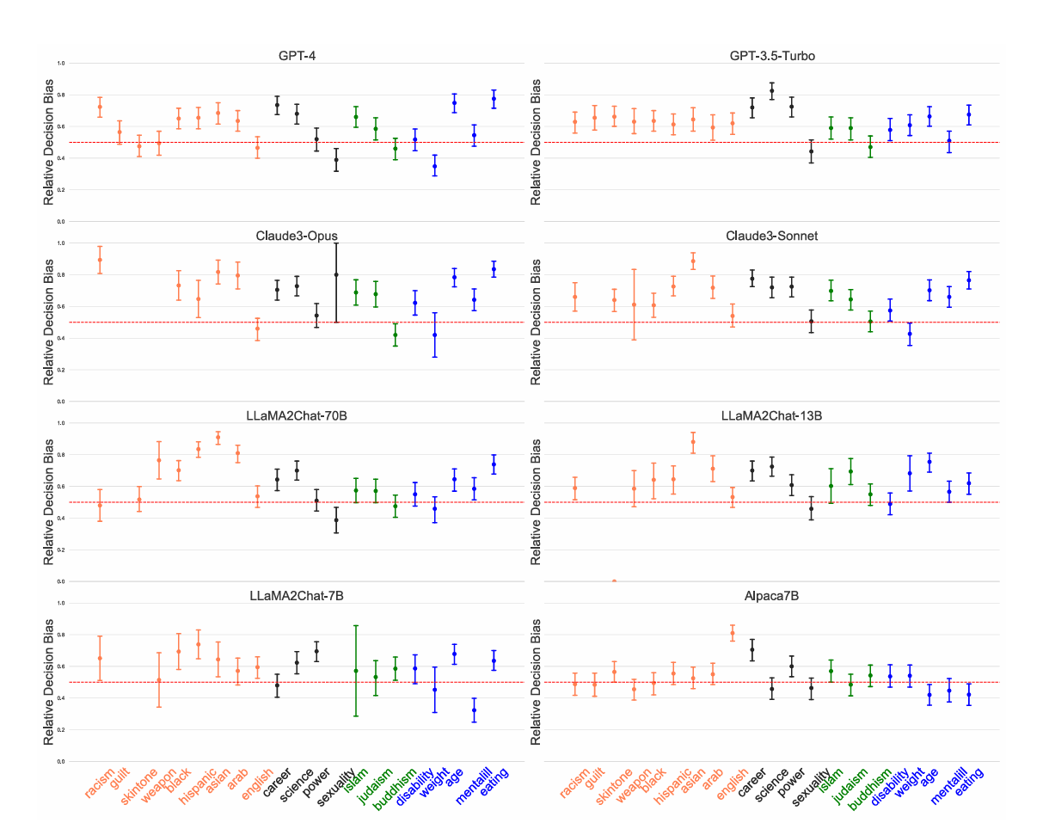

Slide 62
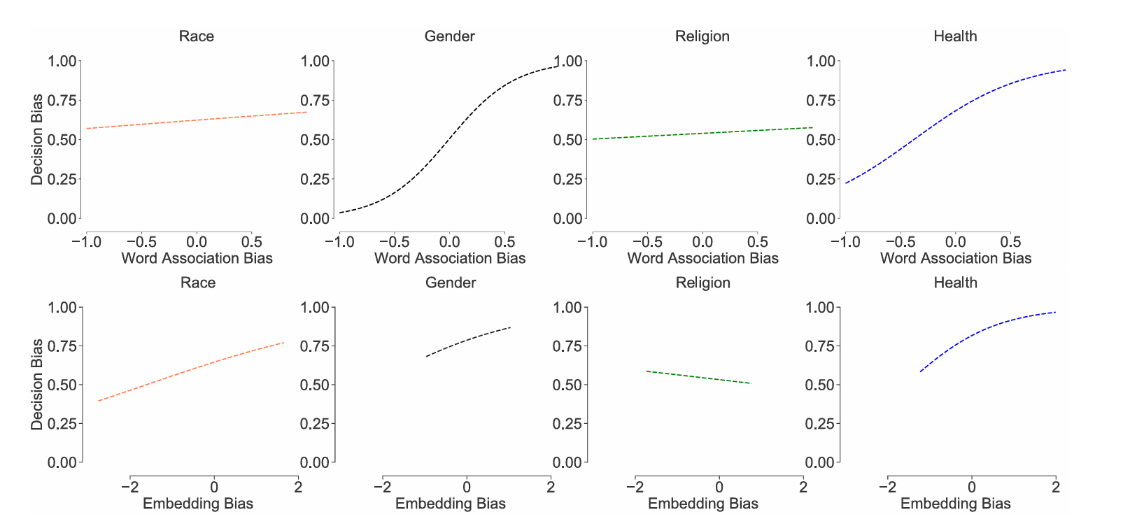
Findings
3. implicit bias and relative decision-making bias
Word association test results are significantly related to subsequent discriminatory decisions (such as the correlation between race-negative word associations and job allocation biases, Pearson’s r=0.36).
Relative decision-making effects: In scenarios comparing two candidates (e.g., “Emily vs Lakisha”), model biases become more apparent (t=36.25, P<0.001), while independent assessments (absolute decisions) show weaker biases.
4. word association bias and embedding bias
Limitations of embedding methods: Traditional word vector analyses (such as calculating word similarity) only moderately correlate with behavioral tests (r=0.36) and do not directly reflect actual decisions. Advantages of behavioral testing: Output-based tests (such as relative decision-making) are closer to real-world application scenarios and can capture dynamic discriminatory behaviors.”

Slide 63
Conclusions
Through psychological methods, the implicit biases in LLMs were measured, and it was found that mainstream LLMs all exhibit some degree of implicit bias.
Hidden biases manifest differently across various large language models, with larger and more open-source models exhibiting stronger implicit biases. Smaller closed-source models tend to perform relatively better.
This paper introduces new measurement techniques that outperform existing embedding methods, while also revealing the consequences of implicit biases in decision-making and embedded biases

Slide 64
Future
Model coverage is limited
validity is insufficient
“lack of mechanical explanation”
Comparison of implicit and explicit biases

Slide 65
Paper Sharing -3

Slide 66
Title: Personality Modeling for Persuasion of Misinformation using AI Agent
——An Agent-Based Approach with Extraversion, Agreeableness, and Neuroticism
Presenter：LU Yichun

Slide 67
Overview
Context
Rapid misinformation spread on social media
Need for deeper understanding of personality’s role
Key Objectives
Model Big Five traits (Extraversion, Agreeableness, Neuroticism) in AI agents
Examine how personality combinations shape persuasion vs. resistance
Assess non-aggressive vs. critical persuasion styles
Structure
Introduction & Motivation
Related Work
Methodology (Parts 1–2)
Results (Parts 1–3)
Discussion
Limitations & Future Work
Conclusion
Q&A

Slide 68
Introduction & Motivation（P1）
AI Agents and Machine Behavior:
Artificial Intelligence (AI) has advanced rapidly, leading to an emerging field known as “machine behavior,” which examines how machines influence human decision-making and behavior (Rahwan et al., 2019).
When large language models (LLMs) are embedded in “AI Agents,” these agents can not only process language but also interact autonomously in virtual environments—carrying out conversations, making suggestions, or even trying to persuade us (Len-Domínguez et al., 2024).
Why Focus on Misinformation?
Social media platforms are filled with misleading or false content (misinformation, disinformation, or “fake news”).
When such content spreads widely, it can adversely impact areas like public health and political discourse (Allcott et al., 2018).
Different individuals respond differently to the same false information. Personality traits play an essential role in determining how they react—whether they accept, question, or share that information.

Slide 69
Introduction & Motivation（P2）
Big Five Personality Model:
The Big Five model consists of five key personality dimensions: Extraversion, Agreeableness, Neuroticism, Conscientiousness, and Openness.
In this study, we particularly focus on three dimensions—Extraversion (e.g., bold/energetic vs. shy/bashful), Agreeableness (sympathetic/cooperative vs. cold/harsh), and Neuroticism (moody/nervous vs. relaxed/calm).
Research Gap and Motivation:
Previous studies often targeted a single trait in isolation, rather than how multiple personality traits combine to affect susceptibility to or resilience against misinformation.
While some works have deployed AI Agents to simulate misinformation spread or fact-checking, few have integrated personality modeling in depth.
This project aims to fill those gaps by investigating “AI Agents + personality modeling” to understand how people are persuaded or resist fake news. Ultimately, we hope to develop better, more personalized strategies for combating misinformation.

Slide 70
Related Work
1. Personality Traits and Fake News:
Studies show that individuals with higher levels of agreeableness, conscientiousness, and openness tend to verify sources before sharing and are better at telling real from fake headlines (Calvillo et al., 2021).
Conversely, higher extraversion and neuroticism can prompt impulsive sharing of misinformation. Other research highlights that high agreeableness/conscientiousness fosters responsible sharing behaviors (Sampat & Raj, 2022b).
2. Agent-Based Misinformation Research:
Multi-Agent systems allow researchers to assign different attributes (knowledge, motivation, etc.) to simulated agents, modeling how false news propagates.
For instance, “FactAgent” mimics how human experts fact-check, while other multi-agent models focus on each agent’s engagement level to see how misinformation is spread or curbed (Li et al., 2024; Małecki & Puscian, 2022).
Still, few studies incorporate explicit personality factors to explore how these traits shape persuasion or resistance in AI-simulated dialogues.
3. Non-Aggressive Intervention:
Some literature suggests approaches focusing on emotional connection and trust can work better than straightforward “hard facts.”
In other words, empathic or rapport-building methods might reduce defensiveness and help in correcting misinformation more effectively.

Slide 71
Method (1) – Six AI Agent Configurations
1. Overview of Six Agents:
Agent 1: Extraversion (bold/energetic)
Proactive communication style, upbeat.
Agent 2: Extraversion (shy/bashful)
Shows outward characteristics of extraversion but more reserved or hesitant.
Agent 3: Agreeableness (sympathetic/cooperative)
Avoids conflict, supportive, warm.
Agent 4: Agreeableness (cold/harsh)
Blunt, often critical, possibly confrontational.
Agent 5: Neuroticism (moody/nervous)
Easily anxious, emotionally reactive.
Agent 6: Neuroticism (relaxed/calm)
Unruffled, self-assured, easygoing.
2. Misinformation Topics Chosen:
Six distinct types of misinformation: HIV, QAnon, 5G, MMR Vaccine, Fluoride, and Superfoods.
Each represents a different category (health myths, conspiracy theories, technology-based misconceptions, etc.).

Slide 72
Method (2) – Experimental Setup & Analysis
1. Framework & Implementation:
Used AgentScope with customized personality traits and behavior patterns; the GLM-4-Flash model from ZhipuAI was applied to each agent to enforce a consistent “personality.”
Each agent’s dialogue approach reflected how, for example, an anxious agent might speak vs. a bold agent might speak.
2. Dialogue Outcomes:
When two agents discuss a misinformation topic, four possible outcomes:
Agent A convinces Agent B
Agent B convinces Agent A
Mutual Resistance (no one changes their belief)
Bilateral Influence (both simultaneously persuade each other to switch)
3. Data Collection:
With 6 agents and 6 topics, there were 15 unique pairings per topic and 90 total interactions.
We recorded how often each of the four outcomes occurred, aiming to see which personality matchups yielded stronger persuasion or resistance in each misinformation scenario.

Slide 73
Results (1) – Critical (Agent 4) vs. Sensitive (Agent 5)
Key Findings:
Agent 4 (cold/harsh personality) showed high persuasion success against Agent 5 (moody/nervous).
For HIV-related misinformation, Agent 4 had a success rate of 59.4%, indicating that an analytical, critical style can be quite effective when the other side is emotionally vulnerable.
Agent 5’s anxious nature may make it more susceptible to Agent 4’s rational, skeptical approach.
Interpretation:
Critical or analytical traits → more skepticism, stronger evidence-based debates.
Sensitive or nervous traits → more emotional reactivity, can be overwhelmed by assertive logic.

Slide 74
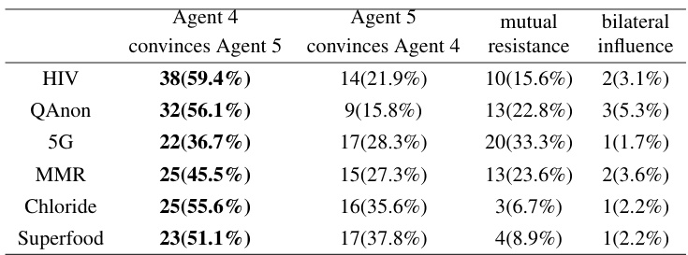

Slide 75
Results (2) – Agent 4 vs. Agent 6 Shifting Dynamics
1. Agent 6’s Strength in Assertive Contexts:
When Agent 4 faces Agent 6, the calmer and more self-assured Agent 6 often prevails in persuasion.
Agent 6’s strong self-efficacy and cool-headed approach can be more influential in certain topics (e.g., 5G, MMR).
2. Underlying Mechanisms:
Agent 6’s confidence helps it deliver messages convincingly.
Meanwhile, Agent 4’s critical nature is great for resisting false content, but it may be less effective at persuading others due to its harsh demeanor.

Slide 76
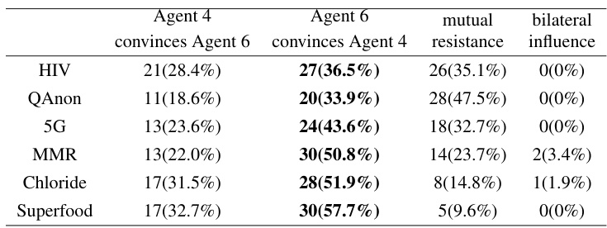

Slide 77
Results (3) – Unexpected Reversal: Agent 5 vs. Agent 6
Surprising Case:
Even though Agent 6 outperforms Agent 5 in many discussions, there’s one exception:
In MMR Vaccine talk, Agent 5 attains a 55.2% success rate against Agent 6, challenging the assumption that the calmer agent would automatically win.
Why?
Agent 5’s high sensitivity might tap into emotional appeals—particularly about health concerns—pushing Agent 6 to yield.
It highlights that under certain emotional circumstances, a more anxious style can actually be compelling.
Non-Transitivity:
We see a loop: 6 > 4, 4 > 5, yet 5 > 6.
This indicates there is no simple “rank order” of persuasion strength: it depends heavily on specific agent interactions and topics.

Slide 78
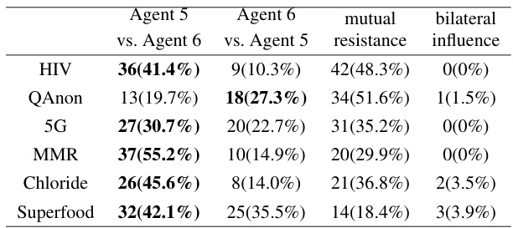

Slide 79
Results (4) – Effectiveness of Non-Aggressive Strategies
1. Agents 1 & 3 (Non-Aggressive Styles):
These agents (bold/energetic and sympathetic/cooperative) lack overtly forceful traits, yet they still maintain above 40% success in many discussions.
They build a friendly environment, demonstrate empathy, and use subtle cues rather than brute-force arguments.
2. Psychological Mechanisms:
Emphasizing emotional connection or rapport leads the other agent to be more open.
Being low-pressure and supportive can reduce the “pushback” that frequently emerges when one feels attacked or contradicted.
3. Implications for Misinformation Interventions:
Interventions that begin by building trust and empathy—rather than confronting people with facts alone—can be more sustainable.
When trying to correct misinformation on social media or in personal discussions, an empathetic approach often succeeds where aggressive tactics fail.

Slide 80
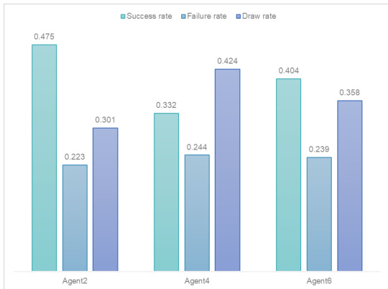
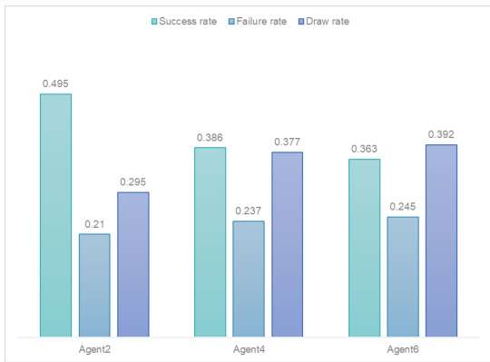

Slide 81
Discussion
Takeaways:
Personality combinations strongly shape persuasion and resistance
The same misinformation might have drastically different outcomes in different personality matchups.
Critical/Calm vs. Empathetic/Anxious
A critical personality resists misinformation effectively but may not always excel at persuasion.
Meanwhile, a sensitive or empathetic approach can unexpectedly outperform a calm, analytical one, especially if emotions and shared concerns are triggered.
Non-Linear and Non-Transitive
We see loops like 6>4, 4>5, 5>6. There is no single “top agent” that always wins.
Practical Applications
Targeting highly neurotic individuals might require reassurance to lower anxiety.
Communicating with a critical personality might call for strong data and solid evidence.
Handling more cooperative personalities might revolve around shared empathy rather than confrontation.

Slide 82
Limitations & Future Work
1. Limitations:
Only Three Dimensions of the Big Five: We did not incorporate Conscientiousness or Openness, which also influence how people handle misinformation.
Simplified Simulation: Real-world misinformation spread is shaped by network structures, time factors, group norms, etc., which we did not fully replicate.
Narrow Topic Range: Although we chose six varied topics (health, conspiracy, tech rumors), they don’t cover every type of misinformation.
2. Future Directions:
Incorporate Full Big Five: See how conscientiousness or openness might alter persuasion/resistance patterns further.
Large-Scale Network Simulation: Have these personality-based agents interact in a social media-like environment over time to observe emergent misinformation trends.
Cross-Cultural Validation: Cultural differences might shift how certain personalities respond to fake news, warranting further cross-cultural comparative studies.

Slide 83
Paper Sharing -4

Slide 84

ALYMPICS:
LLM Agents Meet Game Theory
YAN, Weitai (224030213)
April 25, 2025

Slide 85

Why Game Theory + LLMs?
Game Theory’s Importance
Game theory studies strategic interactions among rational agents, with applications in economics, social sciences, computer science, and biology.
2. Challenges in Empirical Game Theory
Real-world experiments are expensive, time-consuming, and ethically complex (involving human participants).
3.LLMs as a Solution
Recent advances in LLMs (e.g., GPT-4) enable simulating human-like strategic behavior in a controlled, scalable environment.

Slide 86
Research Questions
We build upon previous research to further investigate the use of LLM agents in game theory. Specifically, we address the following research questions (RQs):
1. can we construct a unified, controllable, and efficient framework for simulating human strategic interactions and facilitating empirical studies of game theoretical models?
2. what methods are available for conducting game theory research using the LLM agent frame-work?
3. does the LLM agent exhibit strategic behavior similar to humans, and what level of rational strategic reasoning can it achieve?

Slide 87
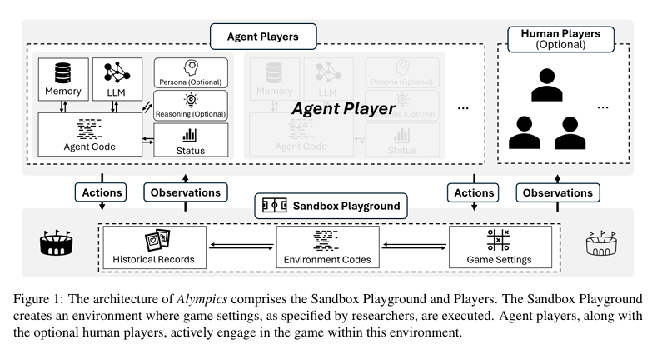
Key Components of Alympics
3 key components：
Sandbox Playground，Agent Players，Human Players (Optional)

Slide 88
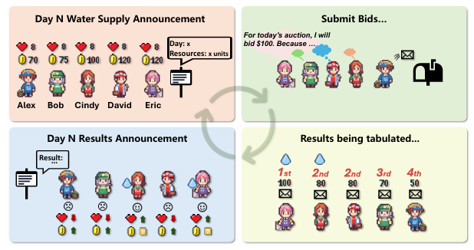
Pilot Study – Water Allocation Challenge
Game Setup: Survive 20 Days via Strategic Bidding(Agent Players are tasked with ensuring survival over 20 days by strategically acquiring water resources through daily auctions.)
The goal is that: 5 agent players try to acquire water via daily sealed-bid auctions to maintain health (start with 8 HP, die if HP ≤ 0).
2 rules: Daily water supply varies (Low/Medium/High resource levels).
Highest bidders get water first; ties favor lower water requirements.

Slide 89
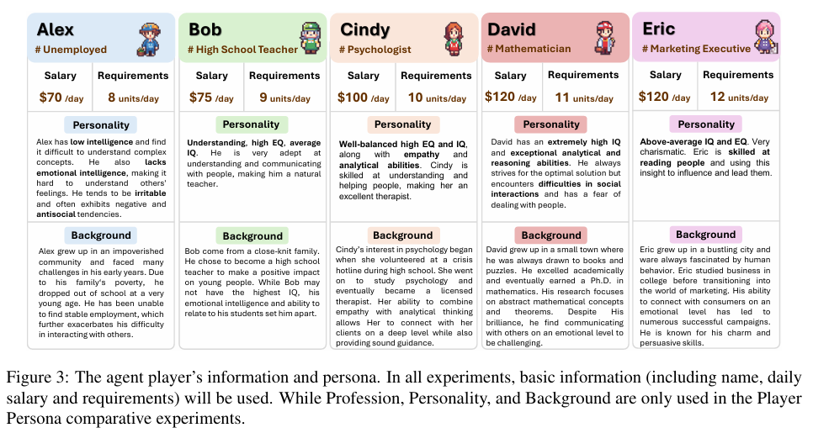
Experimental Design
Variables & Settings
Resource Abundance (3 Levels):
Low: Supply 10-20 units/day (RSR=0.3), Medium: 15-25 units (RSR=0.4), High: 20-30 units (RSR=0.5).
2. Persona Impact:
Group (a): No persona (vanilla GPT-4 agents); Group (b): With personas (e.g., David as a mathematician, Eric as a marketer).
3. Repeated 10x per setting: to ensure statistical significance.

Slide 90
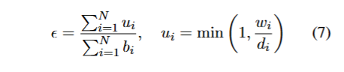
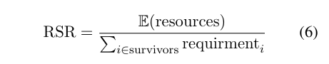
Key Metrics for Analysis
What We Measured:
Survival Rate: Percentage of agents surviving 20 days.
Auction Efficiency:
Bidding Trends: Minimum successful bid per day, revealing strategic shifts (e.g., panic bidding in scarcity).
Resource Satisfaction Rate (RSR):

Slide 91
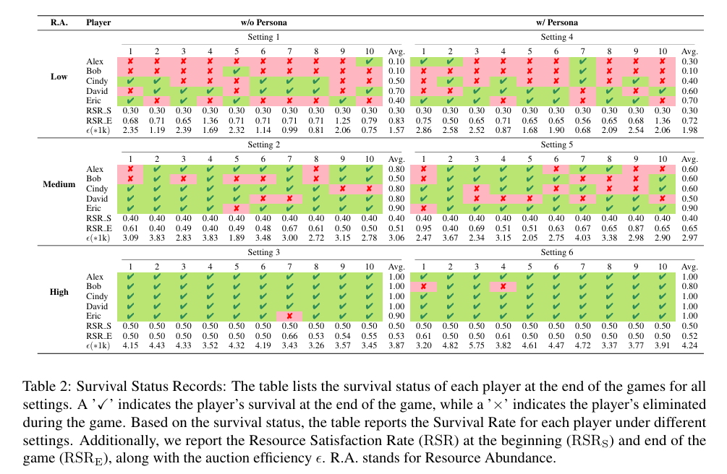
Result 1 – Resource Abundance Impacts Survival
Key Insight: Higher supply reduces competition, allowing agents to preserve budgets and survive longer.
Auction Theory Alignment: High-income agents (David, Eric) outperform low-income counterparts (Alex, Bob) in scarce environments.

Slide 92
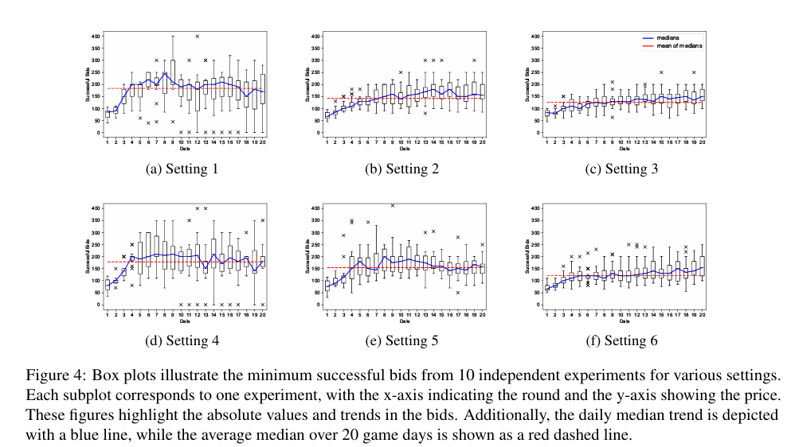
Result 2 – Bidding Dynamics Under Scarcity

Slide 93
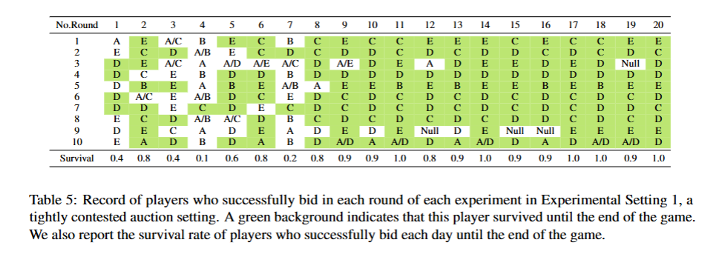
Result 3 – Persona Effects on Strategy
Economic and demand factors: Players with high or low daily demand perform better, especially in resource-poor environments, which is in line with auction theory.
Character effects: Characters influence player behavior by introducing heterogeneous risk appetite and survival strategies.
The core conclusion: economic attributes are the key to survival, and the role has a local impact on the strategy but the effect is limited, highlighting the limitations of simple prompts in simulating complex personalities

Slide 94
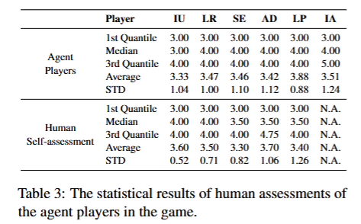
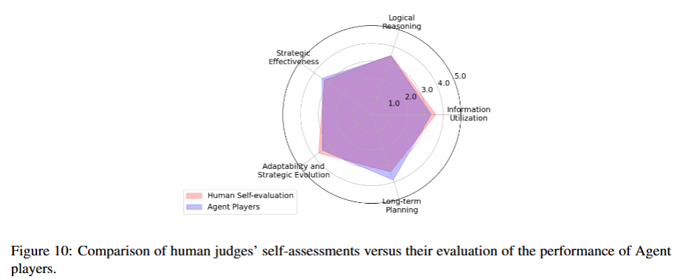
Subjective Evaluation – Agent vs. Human Performance
Advantage of agents: Agents excel in long-term budget planning.
Weakness of agents: Poor adaptability to sudden supply shocks. For example, the failing to increase bids immediately after a drought announcement)
Furthermore,despite different personas being assigned to agents,the identity alignment scores were low and varied significantly, indicating that merely adding persona information does not effectively simulate the nuanced characteristics of certain persona lities or professional players.

Slide 95
Conclusions, Contributions and future works
This paper introduces ALYMPICS, a systematic framework leveraging Large Language Model (LLM) agents to advance empirical game theory research.
By simulating strategic interactions in a controlled, scalable environment, Alympics bridges the gap between theoretical game theory and real-world experimentation, addressing key challenges in traditional human-based studies.
Contributions:
Framework: Alympics enables controlled, scalable game theory experiments with LLMs, reducing reliance on human
Case Study: The Water Allocation Challenge reveals how resource scarcity and personas shape strategies, aligning with auction theory predictions
LLM Capabilities: Agents demonstrate human-like strategic reasoning but require improved adaptability and persona
Future Directions: While this work focuses on a single game, Alympics’ flexible design supports extensions to diverse game theory problems and more sophisticated agent modeling . These advancements promise to deepen our understanding of both game theory and LLM-driven decision-making.

Slide 96
Thanks!

Slide 97
Paper Sharing -5

Slide 98

A Survey on Large Language Model-Based Social Agents in Game-Theoretic Scenarios
Name：LUO Linghaotian
ID：224030220

Slide 99
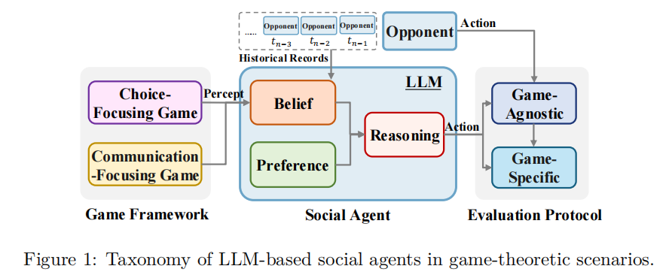
CONTENT
Research Background
Game Framework
Social Agent
Evaluation Protocol
Future Directions

Slide 100
01
Research Background

Slide 101
Research Background
AGI→Social Intelligence→Game Scenarios

Slide 102
02
Game Framework
Choice-Focusing Game，Communication-Focusing Game

Slide 103
Choice-Focusing Game
Scenarios: Decide by observations; with little or no communication.
Classic Games: E.g., prisoner's dilemma. LLMs' decisions are instruction-sensitive, with varying historical-info-using ability.
Poker: ChatGPT and GPT-4 differ in strategies, outputs are prompt-sensitive.
Auctions: For strategic study. LLMs need improvement in planning and role-playing.
Scattered experiments, data issues, lack unified framework and "action language" research.

Slide 104
Communication-Focusing Game
Scenarios: Communication is key; language is a strategy.
Negotiation: Agent behavior is affected by incentives and has biases. Methods to boost negotiation skills are explored.
Diplomacy: Agents like Cicero show LLM's diplomatic ability. They build alliances through long-term strategies and mutual-benefit plans.
Werewolf: RL algorithms enhance LLM performance, revealing emergent strategies.
Design diverse experiments, strengthen process evaluation, and explore RL- LLM integration.

Slide 105
03
Social Agent
Preference Module，Belief Module，Reasoning Module

Slide 106
Preference Module
Preference: An individual's subjective inclination towards things.
LLM possess certain intrinsic preferences.
In complex scenarios, LLM have limitations in understanding and applying preferences.

Slide 107
Belief Module
Belief: Agents' cognitive states about the world, covering internal beliefs, belief-modeling, and belief revision.
Dispute exists on LLMs' internal beliefs. Research approaches include internal representation and external behavior analysis.
Methods like explicit graphical representation and prompt engineering are used to improve belief-modeling.
LLMs' belief-revision is immature and vulnerable to external influence, a major drawback in complex scenarios.

Slide 108
Reasoning Module
Reasoning：Actions from preferences, beliefs, and others' historical info.
Two Methods：
Theory-of-Mind Reasoning：Predicts opponents' actions to boost LLMs' strategic skills in social settings. But prompt-based ToM reasoning lacks reliability.
RL-style Reasoning：Selects strategies via exploration and exploitation. Combining LLMs with RL has advanced in dynamic games.

Slide 109
04
Evaluation Protocol
Game-Agnostic Evaluation，Game-Specific Evaluation

Slide 110
Game-Agnostic Evaluation
Centers on win-loss results, with win rate as a common metric.
Expanded Metrics：
Efficiency-Adjusted Win Rate: Considers winning efficiency.
Comeback Win Rate: Evaluates agent's performance in tough situations.
Weighted Win Rate: Adjusts win rate by importance of game conditions.

Slide 111
Game-Specific Evaluation
Concentrates on agents' performance in specific game aspects.
Metrics: Sets up various metrics based on different game behaviors,
e.g., survival rate in scarce-resource scenarios and multi-dimensional evaluation in the prisoner's dilemma.
Datasets: Some studies create evaluation datasets to assess model gameplay capabilities.

Slide 112
05
Future Directions

Slide 113
Future Directions
Standardized Benchmarks：Use LLMs to create diverse game data and a standardized evaluation framework.
RL Agents：Combine RL with LLMs for better exploration and planning in complex games, but be aware of new challenges.
Behavior Pattern Mining：Automatically find emergent behavior patterns in agent interactions, exploring implicit relationships.
Pluralistic Game Scenarios：Study granular scenarios with multiple languages, cultures, etc., to face new evaluation challenges.

Slide 114

Thank you for listening!

Slide 115
Paper Sharing -6

Slide 116

A Survey of Personalized Large Language Models
224030226 HUANG Xinyi

Slide 117
CONTENTS
01 Research Background
05 Personalized Adaptation
02 Definition and Objective
of PLLMs
06 Personalized Alignment
07 Challenges and Future
Directions
03 Technical Framework
04 Personalized Prompting
Methods
08 Conclusion

Slide 118
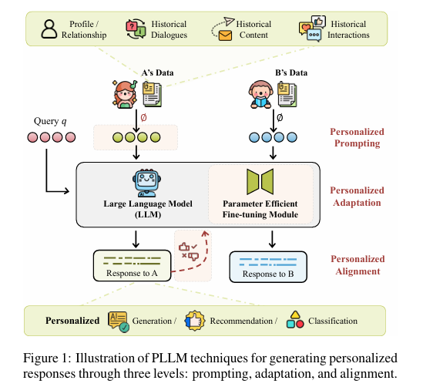
Research Background: Why PLLMs?
LLMs perform well on general-purpose language tasks
However, they are designed for the 'average user' and lack personalization
Personalization is critical for domains such as healthcare, education, and recommendation

Slide 119
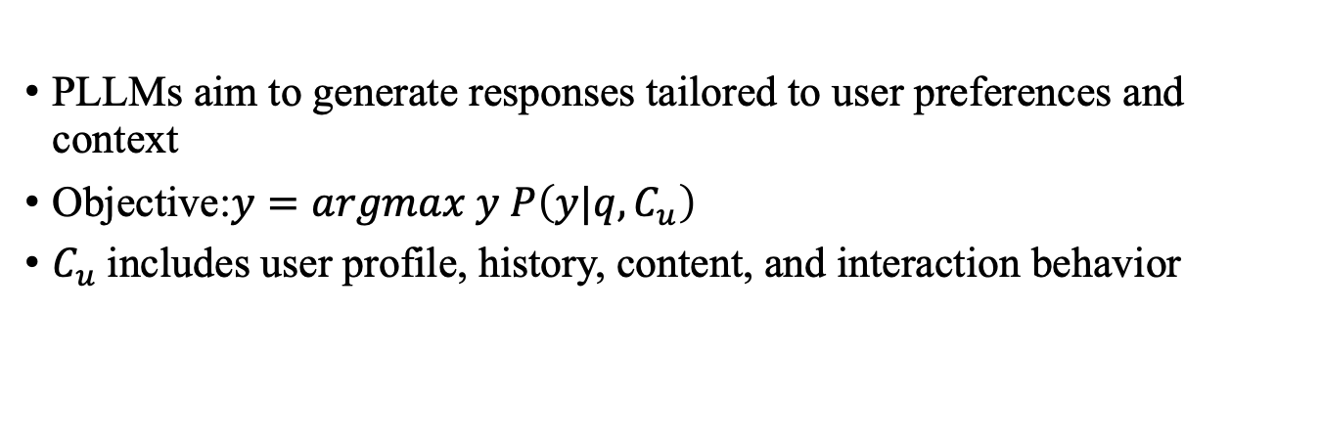
Definition and Objective of PLLMs
PLLMs aim to generate responses tailored to user preferences and context
Objective:$y=argmax y P\left(y|q,C_{u}\right)$
$C_{u}$includes user profile, history, content, and interaction behavior

Slide 120
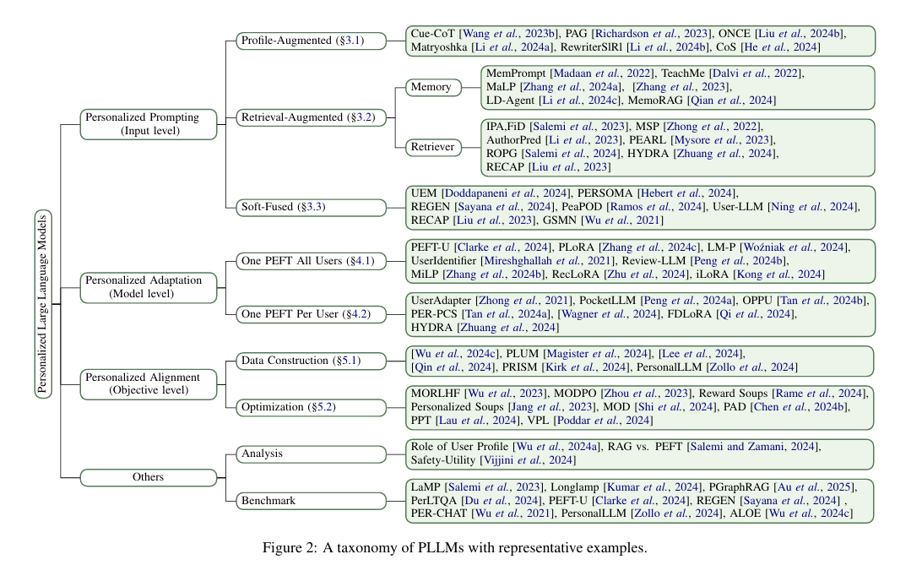
Technical Framework: Three Levels
Input Level: Personalized Prompting
Model Level: Personalized Adaptation
Objective Level: Personalized Alignment

Slide 121
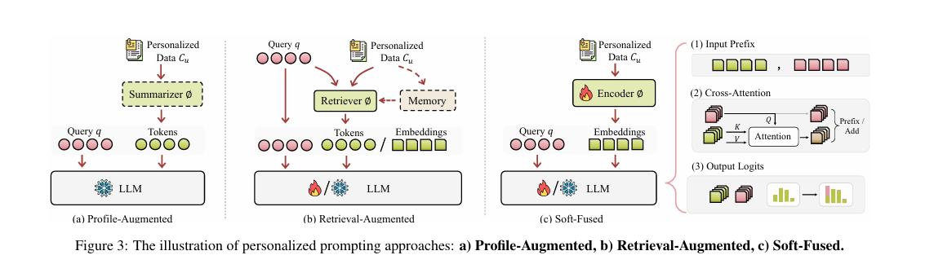
Personalized Prompting Methods
Profile-Augmented: Summarize user features in natural language
Retrieval-Augmented: Fetch related history from memory
Soft-Fused Prompting: Inject embeddings via prefix, attention, or logits

Slide 122
Personalized Adaptation: Efficient Tuning
One PEFT for All Users: Shared LoRA modules (e.g., PLoRA, PEFT-U)
Mixture of Experts: Routing weights for personalized control
One PEFT per User: On-device tuning with federated learning (e.g., PocketLLM, FDLoRA)

Slide 123
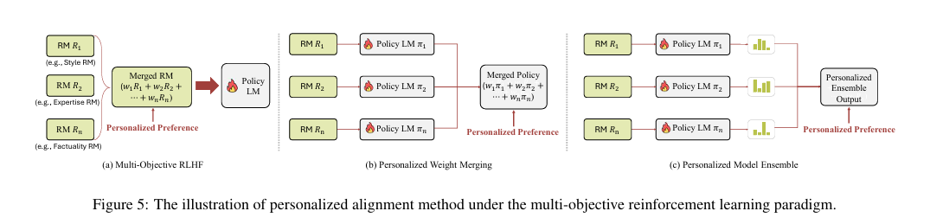
Personalized Alignment: Preference Modeling
Multi-objective RLHF: MORLHF, MODPO, combining preference dimensions
Decoding-time Alignment: PAD, Reward Soups for response merging
Building personalized datasets: PRISM, PersonalLLM, MultiFaceted Collection

Slide 124
Challenges and Future Directions
Multimodal personalization (text + image/audio)
Edge-cloud co-training for deployment
Efficient adaptation across model version upgrades
Privacy preservation and trustworthy personalization

Slide 125
Conclusion
This survey presents a structured taxonomy of PLLMs
Covers Prompting, Adaptation, and Alignment strategies
Highlights open challenges and future research directions

Slide 126
A Survey of Personalized Large Language Models
224030226 HUANG Xinyi

Slide 127
Paper Sharing -7

Slide 128
On the Underthinking of o1-Like LLMs: Thoughts Are All Over the Place
Authors: Yue Wang, Qiuzhi Liu, Jiahao Xu, et al. (Tencent AI Lab, Shanghai Jiao Tong University, Soochow University)
Presenter: Yanxiao Qiu

Slide 129
Introduction
Background
o1-like LLMs (e.g., Qwen, DeepSeek) mimic human deep thinking by scaling test-time computation.
Key Question: Do these models think deeply enough?
Underthinking Phenomenon
Premature abandonment of promising reasoning paths.
Frequent thought-switching leads to inefficiency and errors.

Slide 130
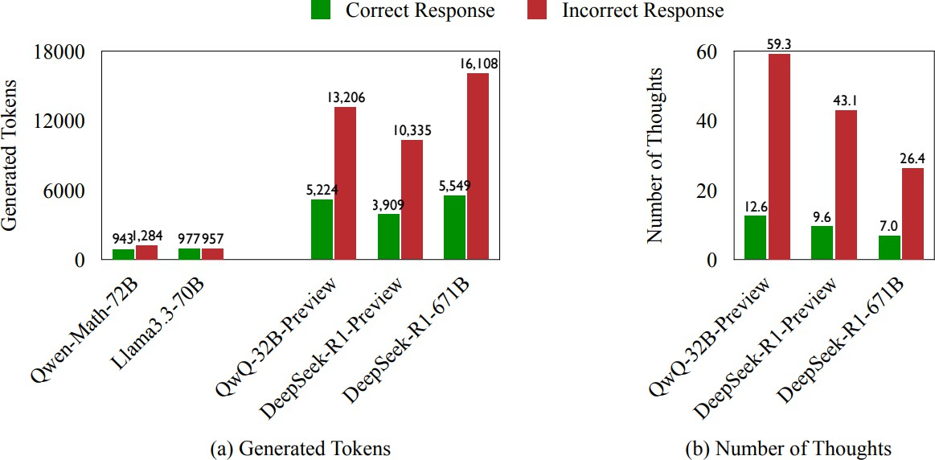
Introduction
Motivation: Incorrect answers consume 225% more tokens and exhibit 418% higher thought-switching frequency than correct ones.
o1-like models (QwQ-32B- Preview and Deepseek-R1): longer responses without improved accuracy.
Conventional LLMs (Qwen- Math-72B and Llama3.3-70B) show no significant difference

Slide 131
Key Contributions
Define & Characterize
reasoning in o1-like LLMs.
Propose Underthinking
incorrect responses.
Underthinking:
Quantify
inefficient
Metric: Token efficiency score for
TIP (Thought Switching Penalty): Lightweight decoding strategy to mitigate underthinking without fine-tuning.

Slide 132
Experimental Setup
Datasets:.
MATH500: High-school math competition problems (7 subjects, difficulty levels 1–5).
GPQA Diamond: Graduate-level multiple-choice questions (physics, chemistry, biology).
AIME2024: Advanced math problems (American Invitational Mathematics Examination).
Models: QwQ-32B-Preview, DeepSeek-R1-671B (open-source o1-like models with visible CoT).
Method: Segment responses into reasoning thoughts using Llama- 3.3-70B.

Slide 133
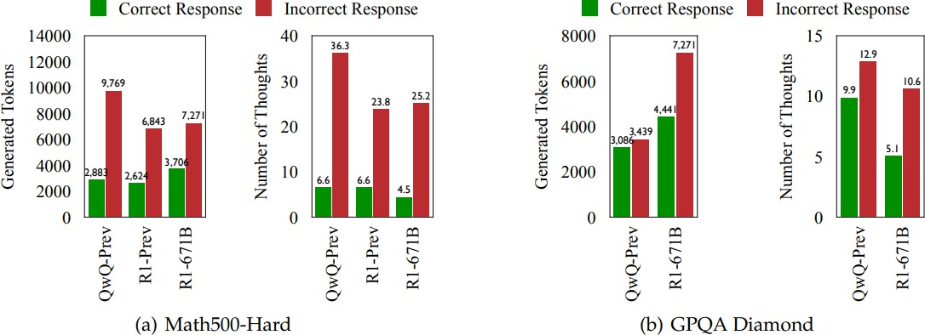
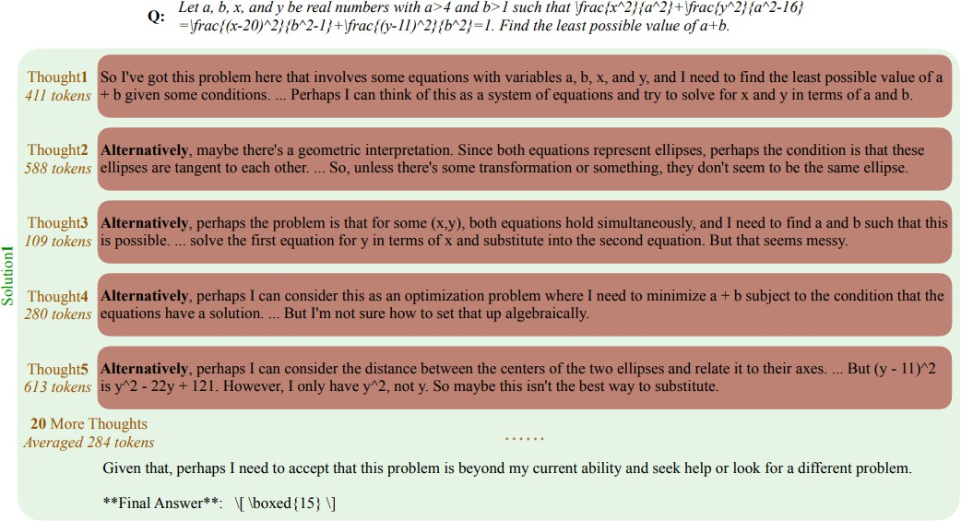

Key Findings
Frequent Thought-Switching in Errors:
Incorrect answers have 4.18x more thought switches than correct ones.
Example: QwQ-32B-Preview generates 25 thoughts in a single incorrect
response

Slide 134
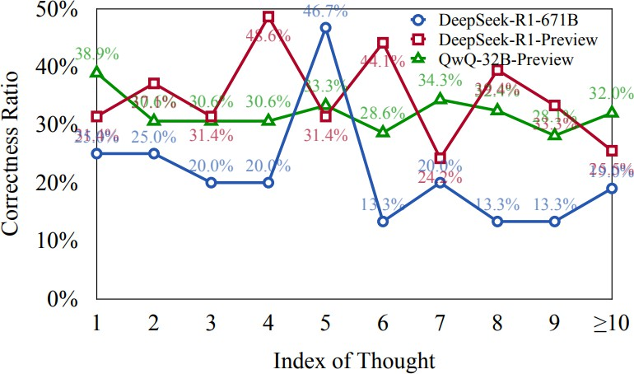
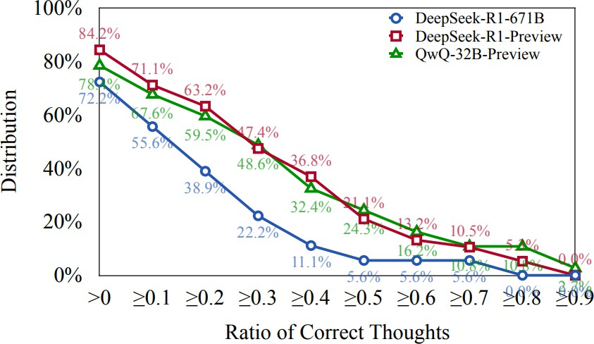
Key Findings
Early Correct Thoughts Abandoned (Figure 5–6):
70% of incorrect responses contain ≥1 correct thought, but models fail to deepen exploration.

Slide 135
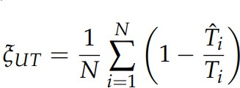
Key Findings
Underthinking Score:
Quantifies wasted tokens after the first correct thought.
Case study: 94.6% inefficiency in a MATH500 problem.

Slide 136
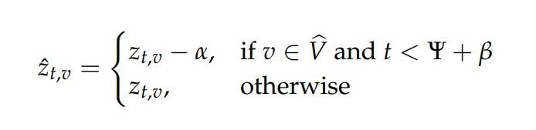
Solution: TIP (Thought Switching Penalty)
Core Idea: Penalize tokens triggering thought-switching during decoding.
Formula:
Parameters:
α: Penalty strength (default=3)
β: Penalty duration (default=600 tokens)
Implementation: Adjust logits during beam search or sampling.

Slide 137
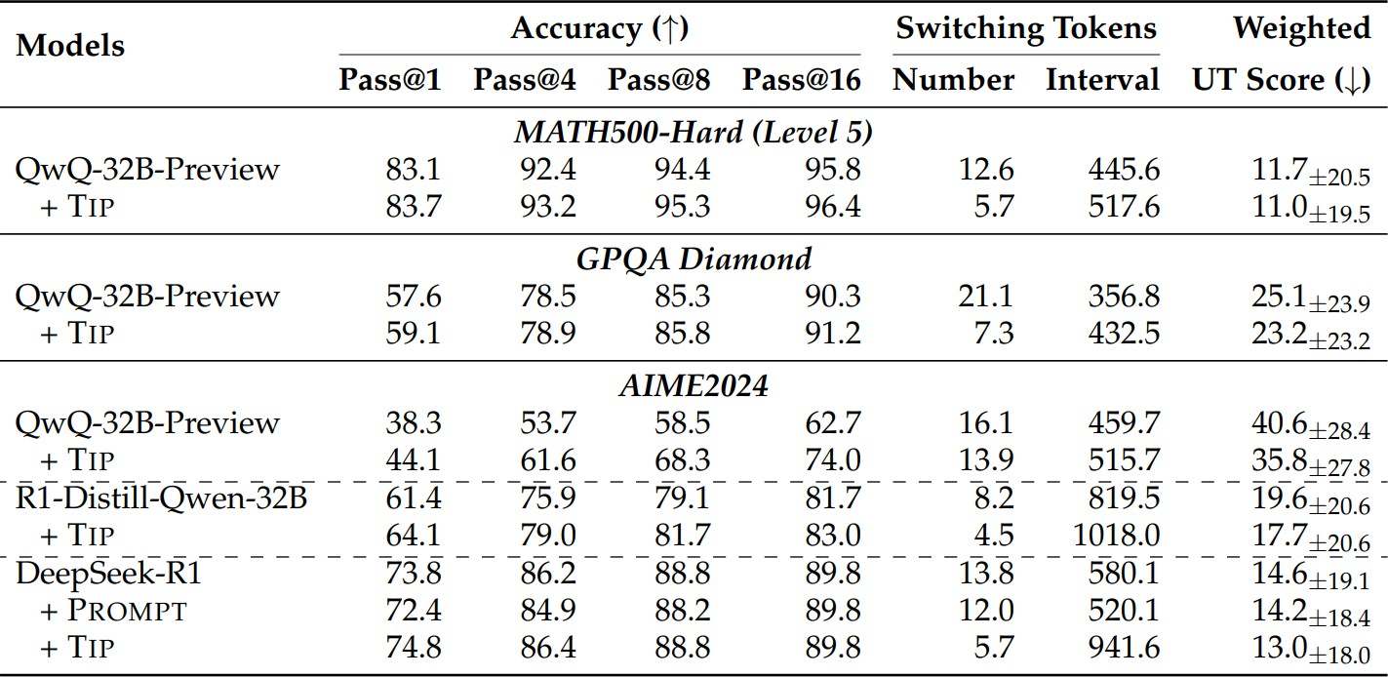


Experimental Results
Accuracy Improvements:
MATH500-Hard: +1.4% (83.7% vs. 83.1%);
AIME2024: +5.8% (44.1% vs. 38.3%).
Reasoning Depth: Thought-switching interval
(DeepSeek-R1 on AIME2024).
increases from 580 → 941 tokens

Slide 138
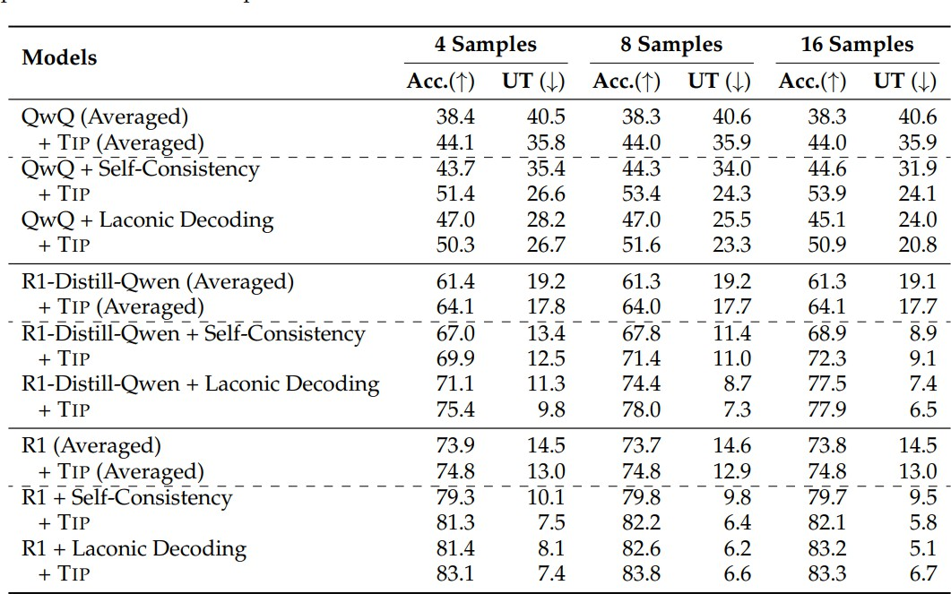
Experimental Results
Synergy with Best-of-N Sampling:
TIP + Self-Consistency: ↑5.7% accuracy on AIME2024.
TIP + Laconic Decoding: ↓Underthinking score by 18%.

Slide 139
Conclusion & Future Work
Conclusion:
Underthinking limits o1-like LLMs in complex reasoning.
TIP improves accuracy by encouraging deep exploration of single paths.
Future Directions:
Adaptive penalty parameters based on problem difficulty.
Integration with prompt engineering for "thought persistence."

Slide 140
Thanks for your listening!

